Slide 1




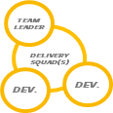
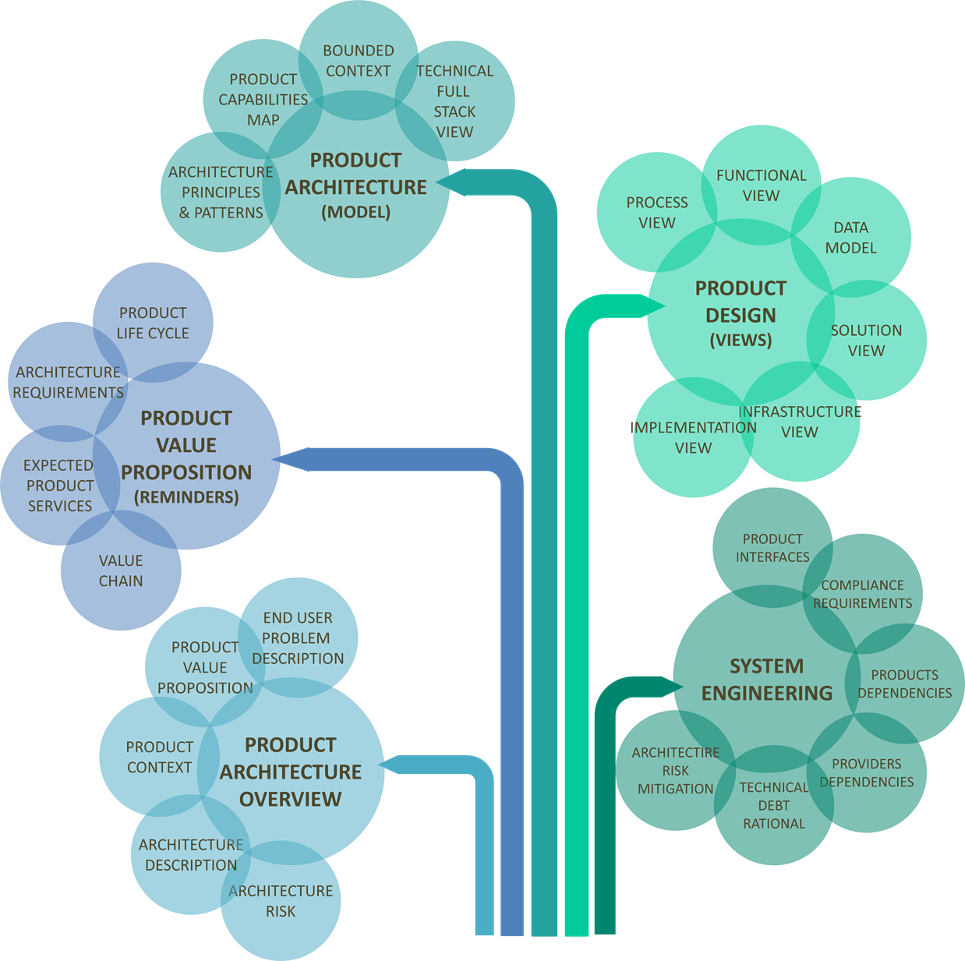




WEEKLY MEETING
90 to 120 minutes
“Weekly are opportunity for architectural refactoring”
SUGGESTED OUTCOMES
PRODUCT
BACKLOG
FACILITATION
ARCHITECTURE DECISION
ARCHITECTURE
RUNWAY
ADR
Kit
DECISION
LOG
PRODUCT BACKLOG
LOCAL
TECHNICAL
DEBT
NEW ARCHITECTURE
ISSUES
ARCHITECTURE
RUNWAY
Kit
BACKLOG
-FEATURES
-ENABLERS
ARCHITECTURE DELIVERABLE
AND MODEL
INCIDENTS
ARCHI
ARCHIMATE
SUGGESTED WAY OF WORKING
GUEST(s)
ARCHITECTURE
MODELS
Information sharing
Architecture decision easily accessible to stakeholders
Let everyone know that you welcome feedback
Keep focus on Architecture topics
DEV.
OPS
TOOLSET
Visual Management
Architecture Kits
ARCHIMATE
Kit
ARCHITECTURE RITUALS
-2020.2 -

